Slide 1
Data Structures
Carrano & Henry,
Chps. 7 - 8
Topic 5 – Queues

Slide 2
Queues
A queue is essentially a line; that it, a first in, first out (FIFO) structure
Used within the OS and to simulate real-world events
Makes sure whenever processes or events must wait

Slide 3
Queues
An entry that was the first or earliest to be added is at the front of the queue
The entry that was added most recently is at the back of the queue
Additions to the queue must occur at the back
Can only look and/or remove the entry at the front

Slide 4
Designing the Queue ADT
The queue will need to support the basic data structure operations that we saw for stacks:
Adding a new item – enqueue
Removing an item – dequeue
Retrieving an item – getFront
Checking if data structure is empty
Clearing the data structure
As with Stacks, we can interact with Queues in limited ways, thus the operations will be simplified

Slide 5
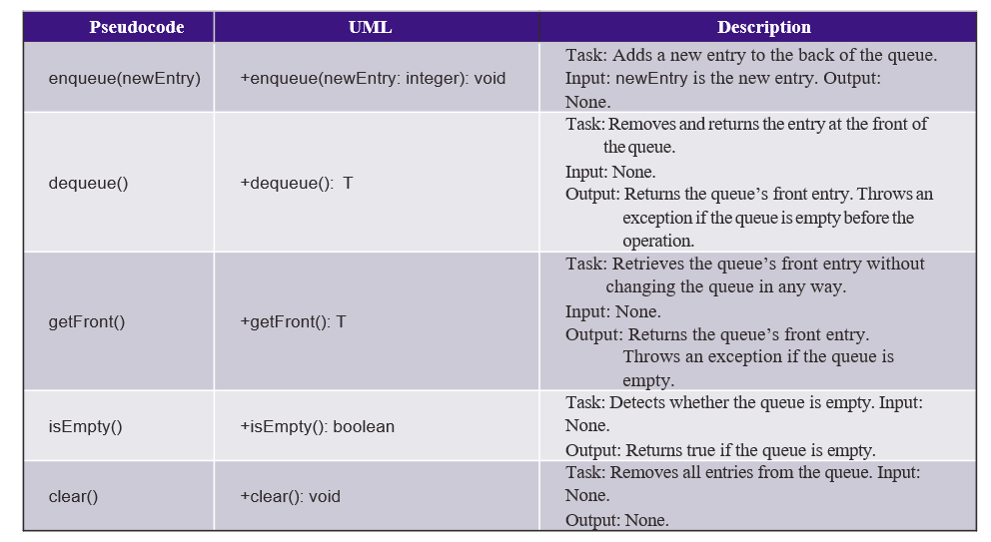
Designing The Queue ADT

Slide 6
Defining the Queue ADT
We can implement our Queue ADT as a Java interface
QueueInterface.java shows an implementation of the Queue ADT
We will throw a NoSuchElement (part of the Java library) when we try to dequeue or getFront from an empty Queue

Slide 7
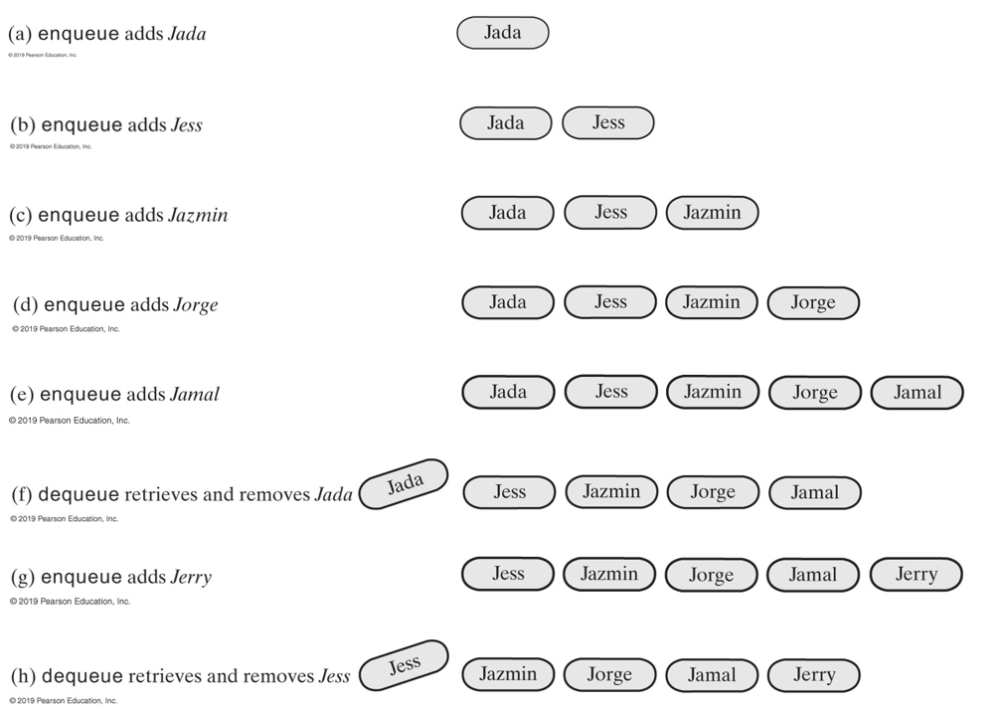
Example of a Queue

Slide 8
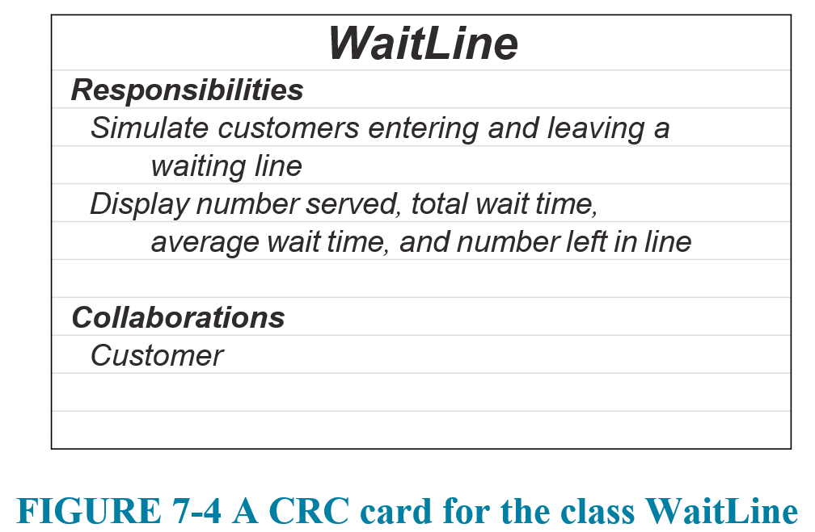
Application: Simulating Waiting In Line
One application of a Queue is to simulate waiting in line

Slide 9
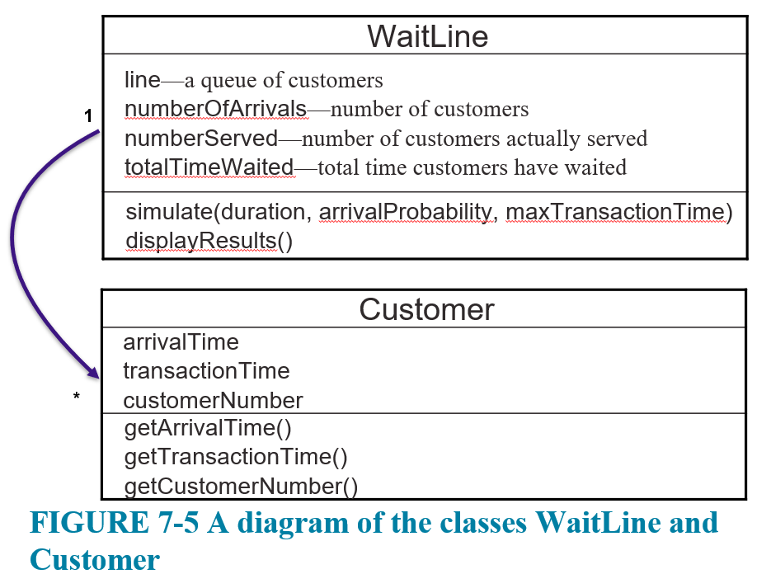
Application: Simulating Waiting In Line
We can model the classes needed:
WaitLine represents the line
Customers will arrive and wait on the
WaitLine

Slide 10
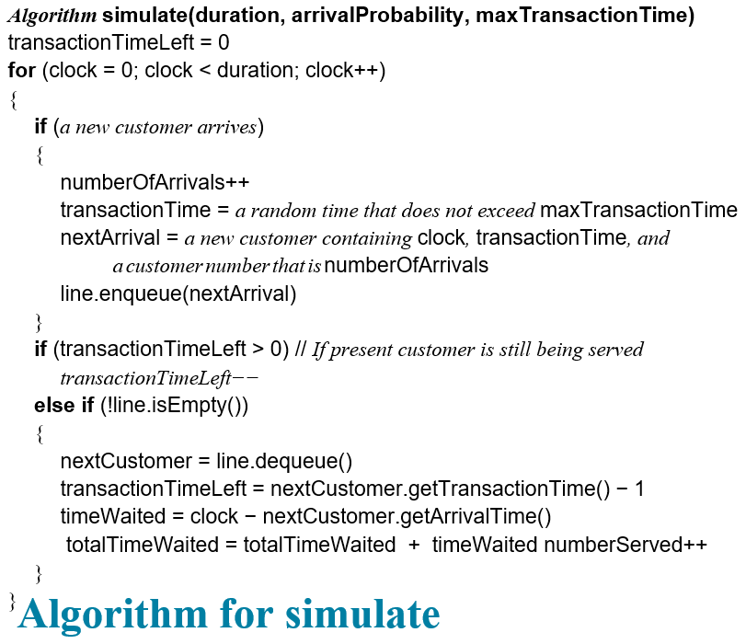
Application: Simulating Waiting In Line
Deal with new arriving customer
Deal with customer currently being served
If no current customer, and if there are waiting customers, take next customer

Slide 11
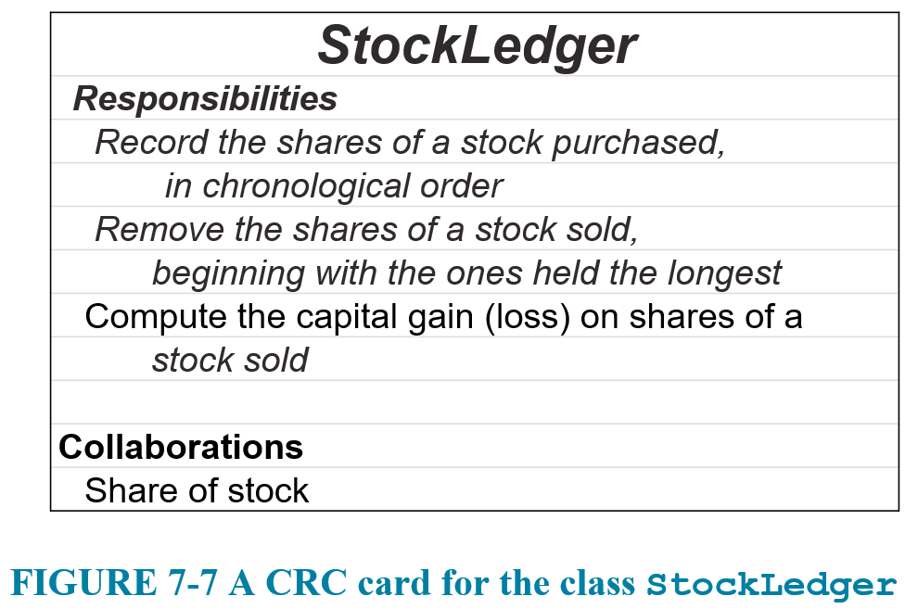
Application: Computing Capital Gains
Queues can be used to compute the capital gains on sale of stock

Slide 12
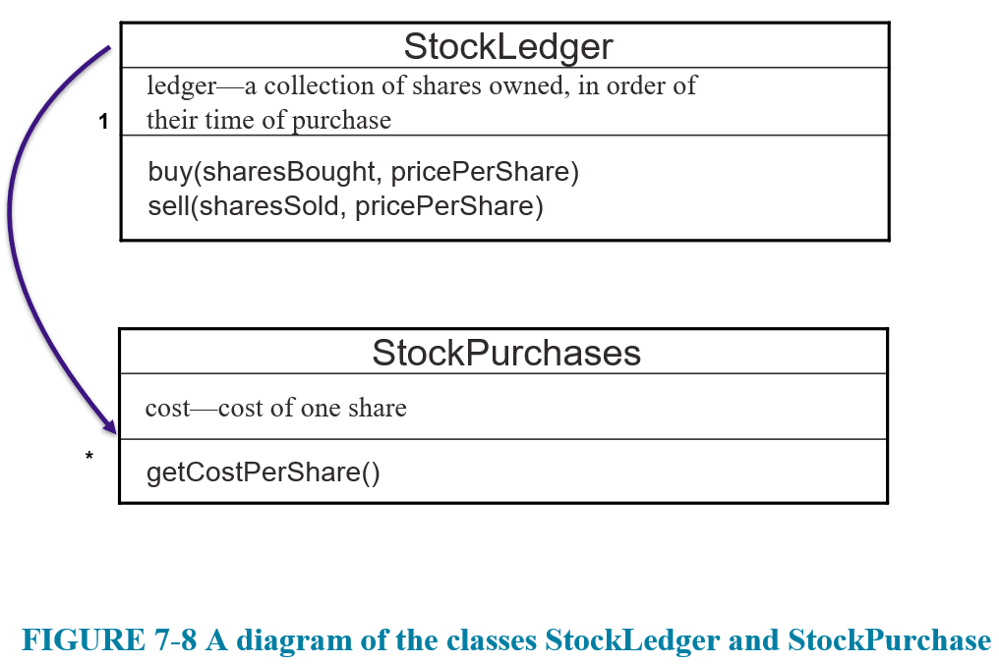
Application: Computing Capital Gains

Slide 13
Implementing a Queue
We can provide multiple implementations of the Queue interface
Linked List
Circular Array

Slide 14
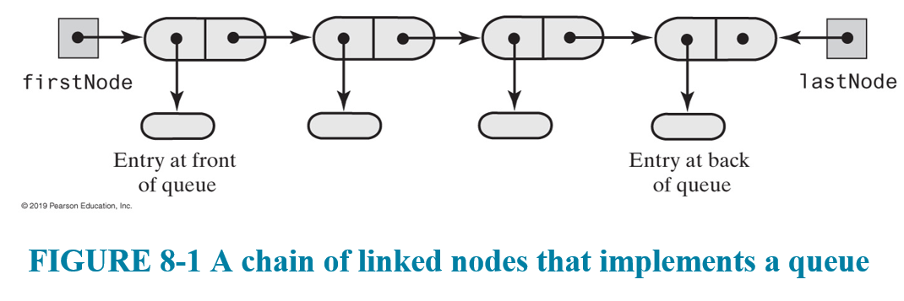
LinkedList Implementation of Queue
We can use a LinkedList, keeping track of both the firstNode and lastNode of the list
Given the rules of the Queue, how should we represent the front and back of the Queue?

Slide 15
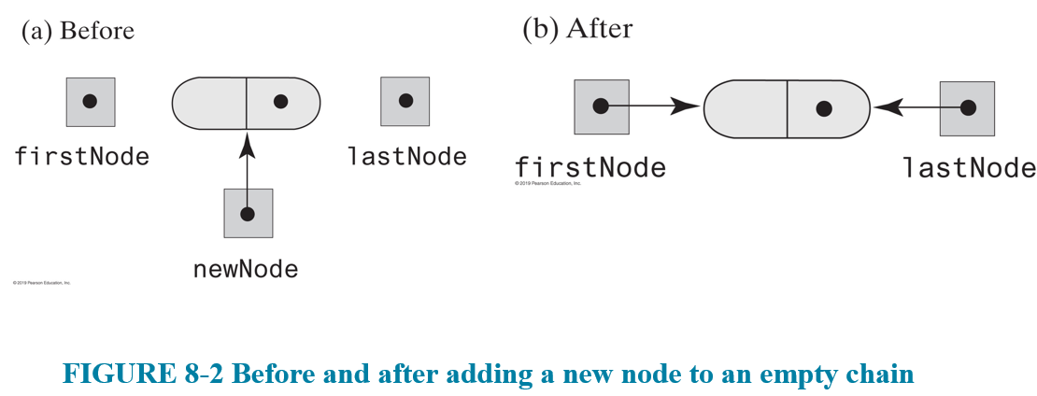
LinkedList Implementation of Queue
With both a firstNode and lastNode reference to maintain, we will have to handle enqueue on an empty Queue as a special case:

Slide 16
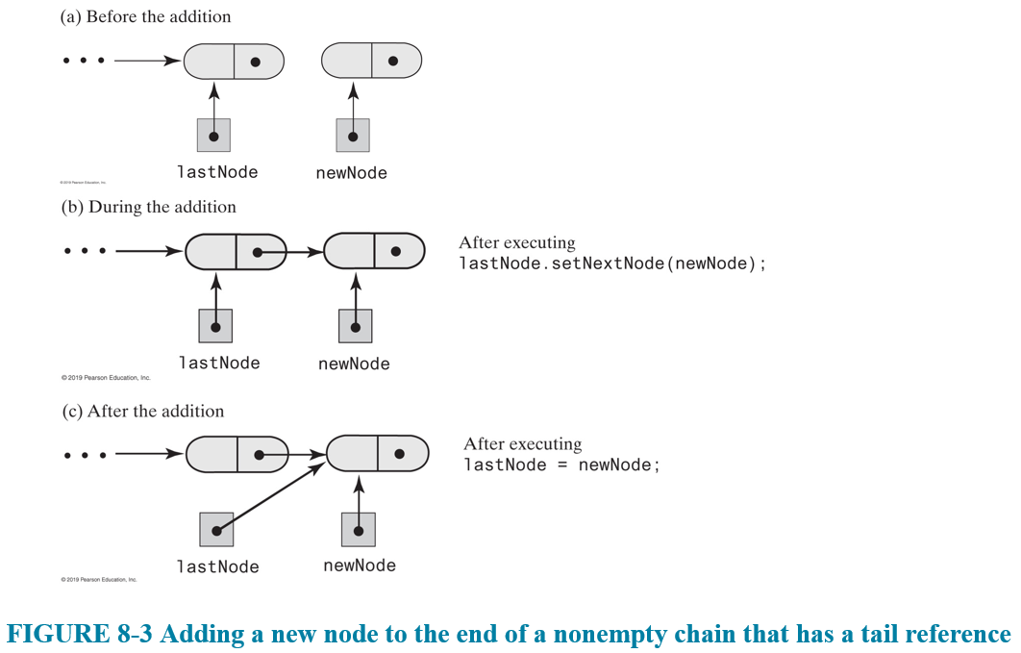
LinkedList Implementation of Queue
In the general case, adding to the back is easy b/c we already have a reference to lastNode:

Slide 17
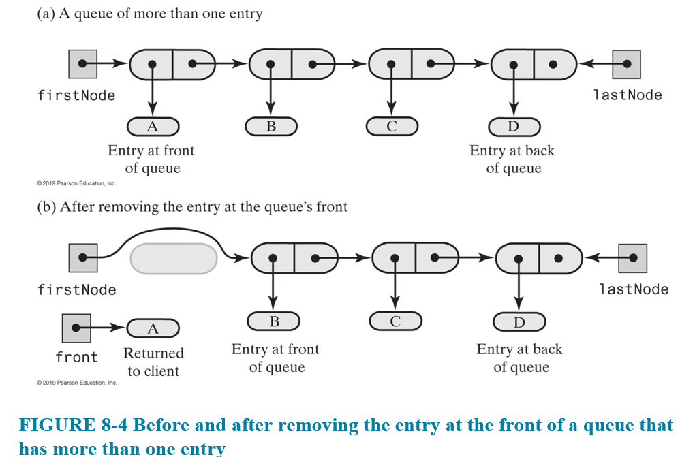
LinkedList Implementation of Queue
Dequeue is just removing the front element of a linked list, which we've already seen (twice)
Only thing is if we remove last Node, we need to set lastNode to null as well

Slide 18
Array Implementation of Queue
We can use an array to implement our queue
But because of how a Queue works, we are going to constantly be updating both the front (by removing elements) and the back (by adding new elements) of the array
How to fix this?
Fix #1 – make the indices (including front and back) relative! Track the frontIndex and backIndex and treat the elements in those respective spots as the front and back
Fix #2 – Make it circular so it wraps around

Slide 19
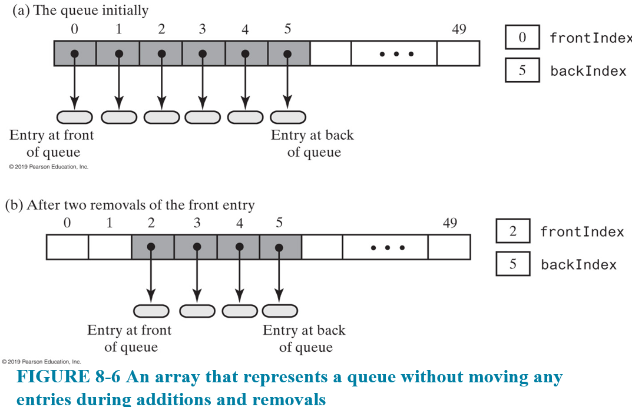
Array Implementation of Queue

Slide 20
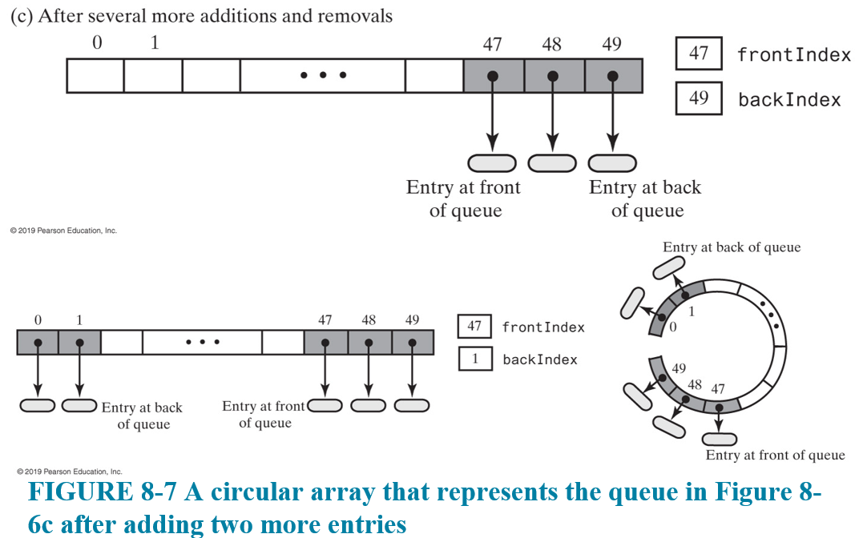
Array Implementation of Queue

Slide 21
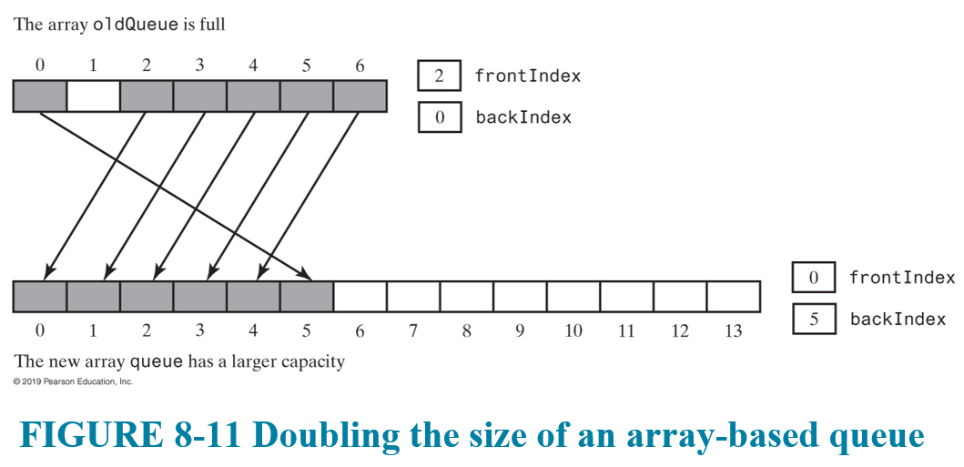
Array Implementation of Queue
Important thing is to make sure we recognize that the array is full (and we don't overwrite the front item)
For safety, we can enforce a buffer of one spot between the backIndex and frontIndex
Also, no reason we can't resize the array when it is full

Slide 22
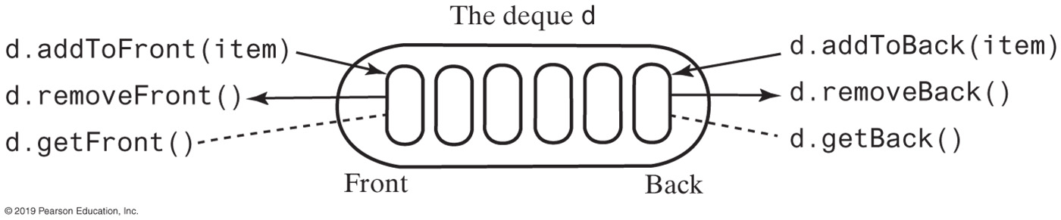
Variation: The Deque
A deque (pronounced "deck") is a double-ended queue
Items can be added to/removed from the front or the back
Can view it as having queue-like and stack-like operations
DequeInterface.java is an implementation of Deque ADT

Slide 23
Variation: The Deque
When you purchase stocks the shares you buy together or grouped together into a "lot"
So in the computing capital gains example, we could use a deque
When we sell shares of stock, you keep grabbing lots of shares purchased, starting from the oldest
If you have leftover shares in a lot, you can easily put the remaining shares of the lot back to the front of the deque by adding to the front

Slide 24
Implementing a Deque
Having a reference to the firstNode and the lastNode makes it possible to enqueue and dequeue in constant time
In a deque, we can add or remove at both spots
We have already seen adding and removing from the front of a linked list is easy and can be done in O(1) time
And with the LinkedQueue, we saw that we can add to the back of the linked list in O(1) time if we have a direct reference to the last Node
But what about removing from the back of the linked list?
We need to access the Node before the last node (to adjust its next pointer and to set it as the new lastNode)

Slide 25
Implementing a Deque
One implementation of a deque can be done using a doubly-linked list
Each Node has three parts: the data, a next pointer, and a previous pointer
Now if each Node has pointers in both directions, we solve the problem of removing from the back
We can access the 2nd to last Node directly (lastNode.previous)
Only caveat is that when manipulating the list, we have to adjust double the pointers for each Node

Slide 26

Variation: The Priority Queue
Sometimes, a line isn't so simple; and not everyone waiting in line is given the same status
A priority queue organizes objects according to their priorities
The definition of "priority" depends on the nature of the items in the queue

Slide 27
Variation: The Priority Queue
Adding to a PriorityQueue does not need to change
But when removing from the PriorityQueue, we should remove the item with the highest priority (and oldest among the items with equal priority)
OR can change how we add to make sure we add according to priority, in which case removing doesn't have to change
PriorityQueueInterface.java is an implementation of the Priority Queue ADT

Slide 28
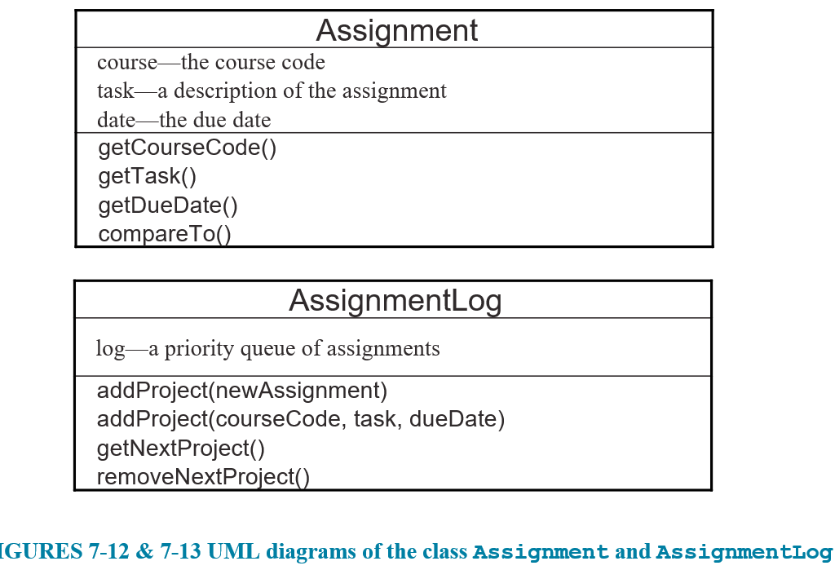
Variation: The Priority Queue
A potential application is a log to track assignments

Slide 29
Implementing a PriorityQueue
There are some choices here
Array based
Linked list based
Either way, would need to have some concept of a priority value
Would be easiest if the priority was attached to the entries themselves
Effect is maintaining a sorted queue, with entries sorted according to their respective priority values

